Slide 1

Discrimination against Women
Old days
Now days
purpose
In west Society
East society
This Phenomenon have already exist for a long time .
Holy Bible
I don’t know.

Slide 2
Discrimination
(against sb) | the practice of treating sb or a particular group in society less fairly than others
age / racial / sex / sexual discrimination (=because of sb's age, race or sex)

Slide 3
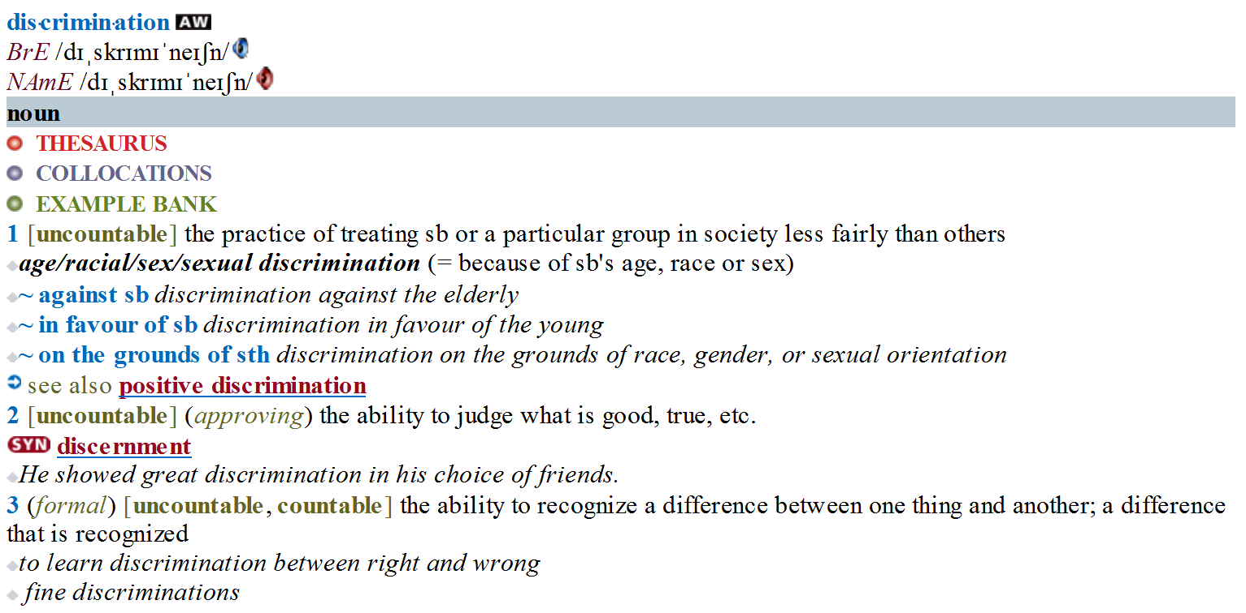
OALD 8

Slide 4
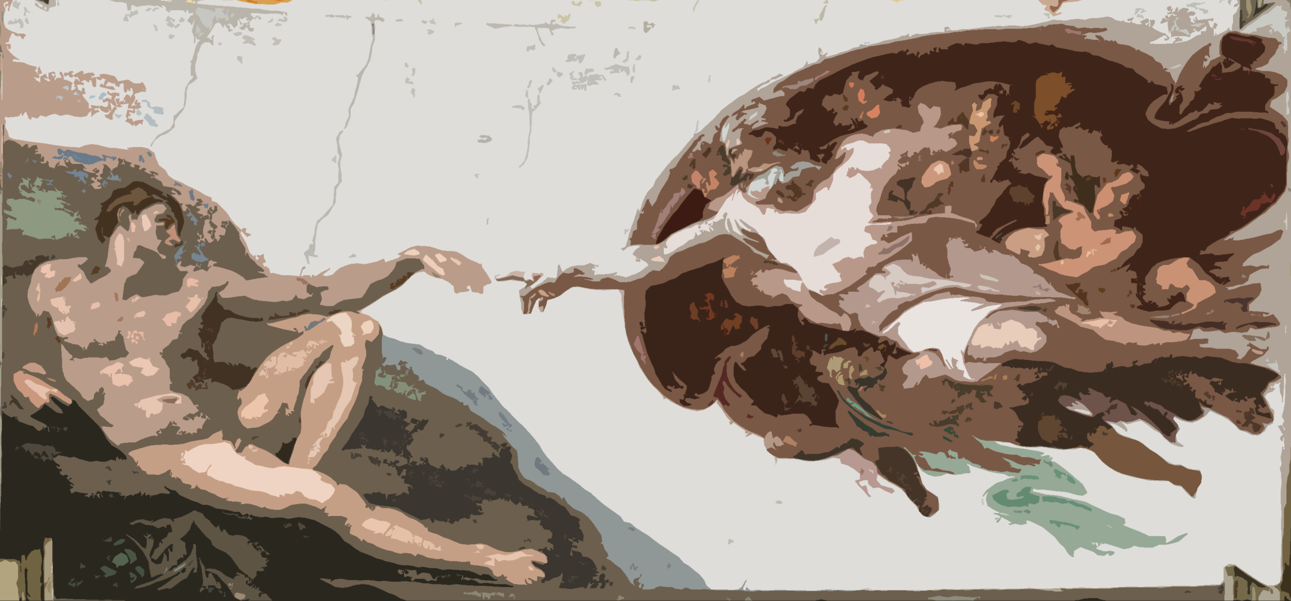

Holy Bible & Ancient western society
God created the world
God created Adam
God created Eva with Adam's rib
Western people get it: Women are Accessory of men.

Slide 5
Nowadays & Western Society
Discrimination based on gender (or sex) is a common civil rights violation that takes many forms, including sexual harassment, pregnancy discrimination, and unequal pay for women who do the same jobs as men.
Unfortunately, most U.S. women are all too familiar with all of these inequalities.
Employment
&
Education

Slide 6
What about the transgender individual?
According to the an American website, civilrights.findlaw.com:
Gender discrimination laws also protect the rights of transgender individuals.

Slide 7
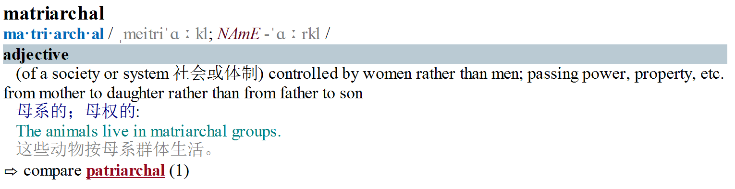
Ancient eastern Society

Slide 8
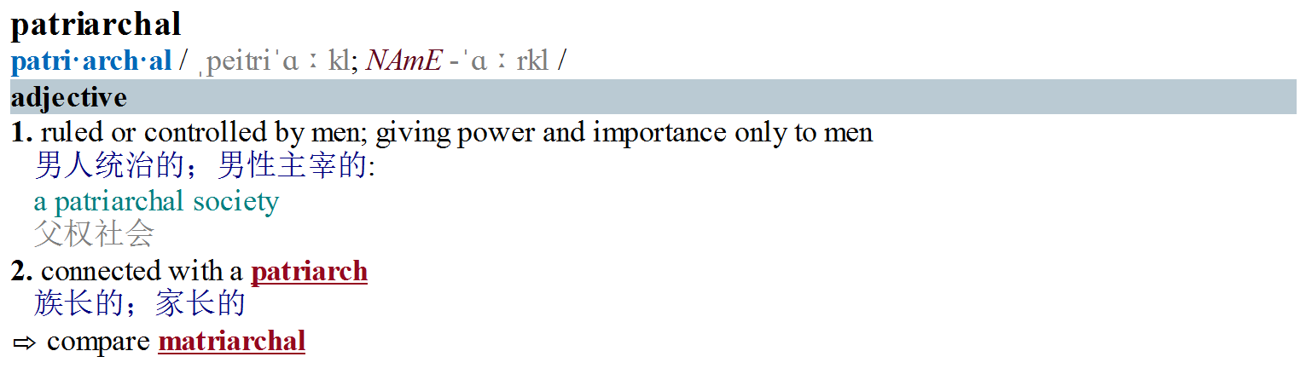
Ancient eastern Society

Slide 9
Now & East Society
A little like western society
No speaking again

Slide 10
The End
No clear difference between the two society
No matter what our ancestor have done or thought, sexual discrimination is very unscientific.
Difference make a better world.

